Slide 1
ACSI CONFERENCE WORKSHOP 2 Thursday 1st September 2022
HOPE FOR THE CHILD WITH LEARNING DIFFICULTIES

Slide 2
2
What are you dong with your gifts and talents?
What have you done with the Zurka bird?
Create something that is going to hold their interest – a game , a craft item, a picture. To add to the theme in the classroom.
Create a place where they feel at peace and know that they can apply themselves without being ridiculed or laughed at when they ask simple questions.

Slide 3
3

Slide 4
4

Slide 5
5

Slide 6
6
Notes:
Pencil holders – theme on safari

Slide 7
7
Get the children to MAKE the double phonic sounds that they are struggling to remember or spell correctly.

Slide 10
Notes:
10. AR double phonic sound

Slide 11
Notes:
11. OI double phonic sound

Slide 12
12.

Slide 13
13
I have a games section – blocks, puzzles, bead board games, abacus sets, magnetic darts ( for the older students) all that come into play at some time during the day.
Craft ideas to help with their learning
Reading to add to their vocabulary and to build on their imagination
Add to their enjoyment of learning in fun ways – using the classroom theme

Slide 14
14 .
New theme for this term is UNDERWATER.
Make sure you have the ideas up on the wall before the first day of the term.
Create the correct atmosphere.

Slide 15
Notes:
15 What would be the conversation between these two characters?

Slide 16
Notes:
16. Tell the story about this fish!!!!

Slide 17
Notes:
17. Why would this fish be so happy?

Slide 18
18
One way to teach plural rules – teach them a rap song – you don’t need to have a voice!!!!
Nouns need plurals, it means more than 1, so let’s get ready to have some fun
Look at most nouns, don’t get in a mess, to make them plural, you just add S
If it ends in an S , an X or a Z, don’t just cry and go to bed, endings CH and SH are the same, if you add ES then you’re still in the game

Slide 19
16
26 letters in our alphabet too, but 5 are the VOWELS that’s A, E, I, O and U
If it ends in a consonant Y oh yes, change the Y to an I then you add ES
If it ends in a vowel with a Y confess, NO I keep the Y then just add S
Nouns that end in F or FE, drop the F, make a V add ES you see.

Slide 20
16 DOUBLE PHONIC SOUNDS
Make up the sets as a craft exercise.
Children get to choose their own sound, or work within the framwork given by the class teacher.

Slide 21
STORY SEQUENCING
Simple steps to ensure that facts are learned.
1. Who, and where?
2. What happened?
3. How did it end ?
Notes:
21

Slide 22
HOW TO HELP THE CHILDREN WITH STORY SEQUENCING
Notes:
22. Story sequencing made easy

Slide 23
23
Put yourself in the place of the child – what might your feelings be? Embarrassment, irritation, frustration, shame.
Add to that having to learn new concepts almost every day when you haven’t even grasped the first!!!! A fisious circle
The reaction or outcome will not be pleasant for you, the child or the rest of the class.
Notes:
21.

Slide 24
24
Start with what they do know.
Remember to go from the visual to the abstract. - before they have to write anything in their books.
Work in an oral discussion before trying to work things out physically.
Find out exactly where the child fits into the concept being learned. – how much do they underrstand?

Slide 25
25
Remember to work on their confidence above everything else.
You are their role model, so your behaviour is extremely important.
You are the one that has to set the boundaries.
Do not let disobedient or disrespectful behaviour to go unchallenged.
Be constant in your requests

Slide 26
26
Think before you speak or react to any situation that may arise.
Identify what causes the trigger reactions
Listen and learn from others
Provide the child with the opportunities to make their own choices. - facts, decisions and consequences.
Be confident in yourself and your position in your class.

Slide 27
27
Remember that they will ALWAYS test your boundaries
Have plans in place to countermand this before it actually happens.
Have things in place to keep them occupied even if you are working with another child.
Above all things make sure that you are praying for each child and that you are aware of the home situation, or boarding, or whatever.

Slide 28
28
Be sure to praise all attempts at doing well., either in classwork, sports, music. – keep up to date with the child’s activities.
Enjoy your work – it is God’s plan and purpose for you, for this season, so do it to the best of your ability

Slide 29
HAND IN YOUR BOOKS
Give them the chance to put their work on the correct pile as they see fit. – work well done, needing help or really not so good because you didn’t try your best. .
Notes:
29

Slide 30
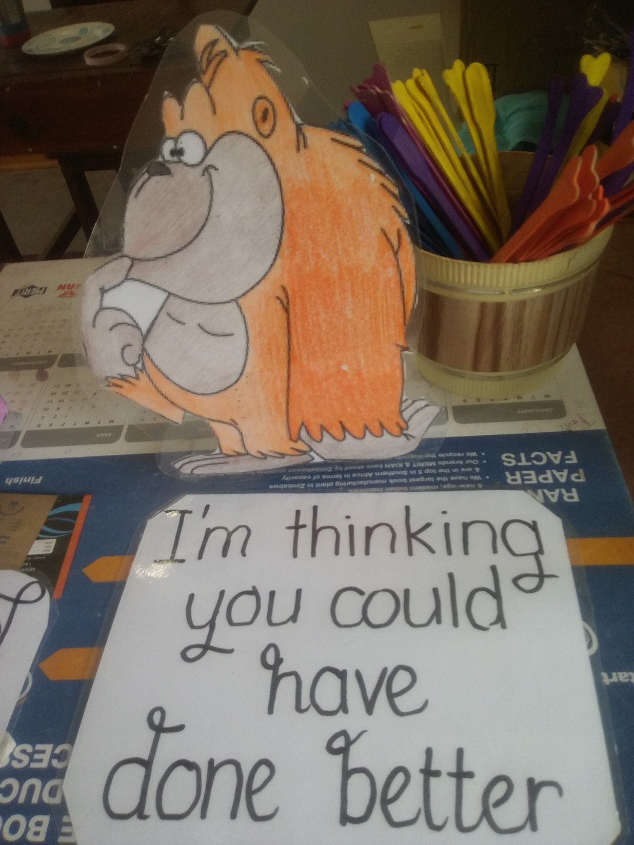

Slide 31
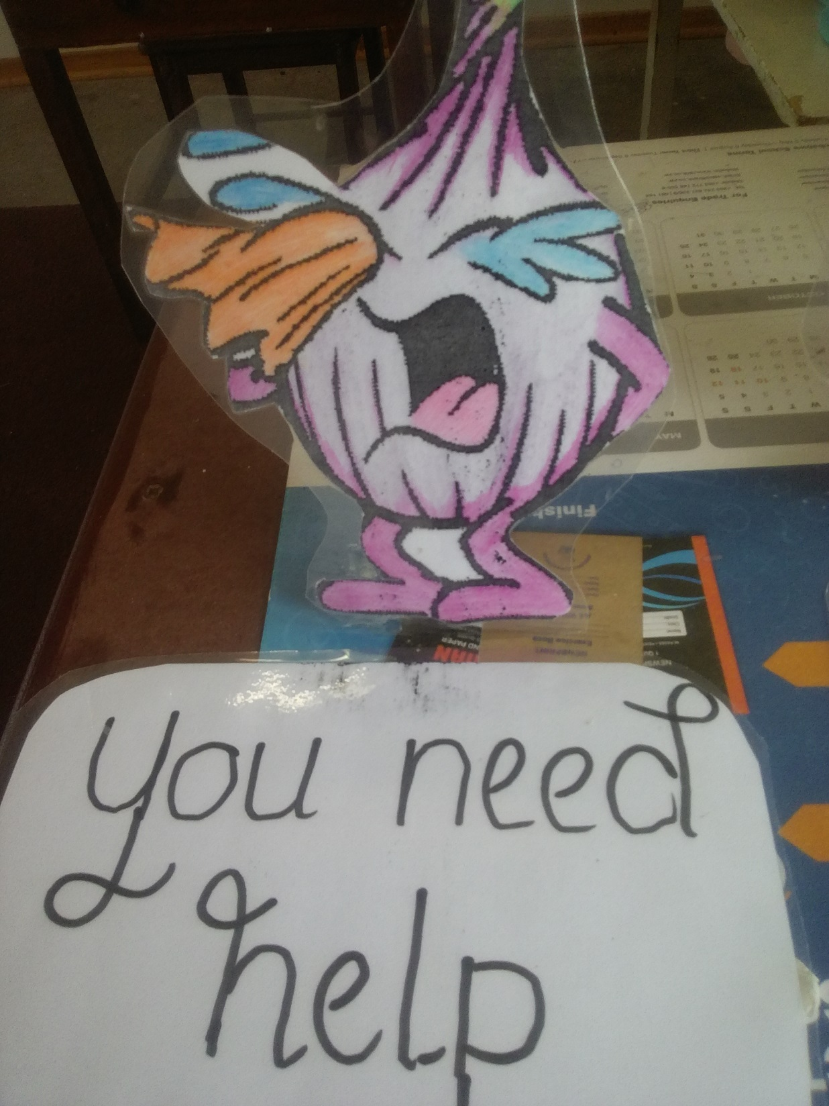

Slide 32
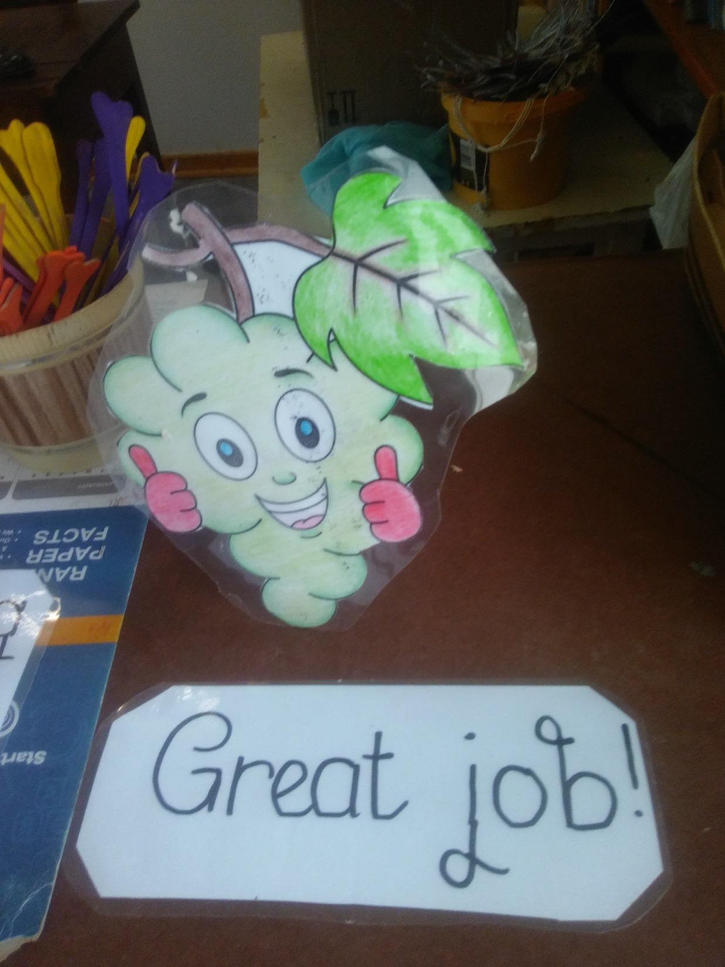
Notes:
32

Slide 33
33
There are many different ways to make a difference in every child’ s life.
Be that person or teacher that they will always remember.

Slide 34
MATCHSTICK BRIDGE CRAFT

Slide 35
JEEP DESK FOR THEME “ON SAFARI”
Notes:
35

Slide 36
DUCK POND – THEME BIRDS
Notes:
36

