Slide 1
ACSI Conference 31/8/2022
WORKSHOP 1
Hope for teachers of pupils who struggle

Slide 2
1.
Walk with me through my classroom a minute.
Colour and fun reading is the core to the teaching of those who are struggling.
It must show them that there is HOPE because learning is real, but learning can be fun.

Slide 3
Dig deeper, jump further, climb higher.
Notes:
2.

Slide 4
Notes:
4

Slide 5
5
W – hen you
E – nter this room
L earning is fun
C o—operation is expected
O ur positive attitude and
M utual respect are part of
E verything we say and do.
Notes:
5

Slide 6
Notes:
6.

Slide 7
7
Notes:
7. Take a quick glance around our classroom

Slide 8
8
Notes:
8. Our theme was birds this term

Slide 9
9
Notes:
69 Can you name the different birds that you can see?

Slide 10
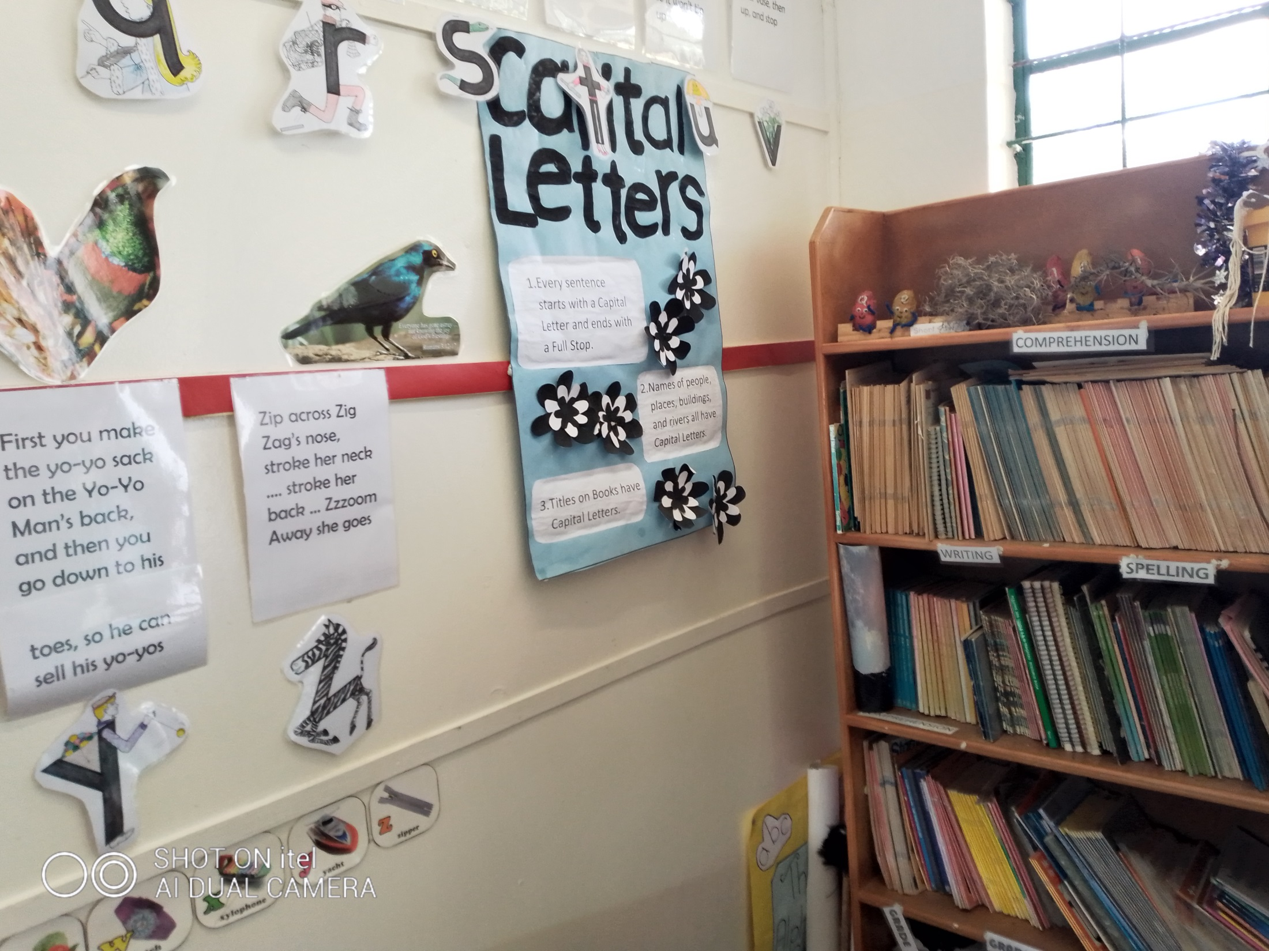
Notes:
7.10

Slide 11
What is Hope? 11.
- a feeling of expectation and desire for a particular thing to happen
an optimistic state of mind based on an expectation of positive outcomes.
Expect with confidence
Notes:
10

Slide 12
12.
There is always HOPE
What impact are you having in your area of influence? - other staff members, administrative staff, parents, ground staff, members of the public
How do you know you are in the right place, right now, doing the right thing?

Slide 13
13.
Obtain your P.PH.D. – A PHD is the highest level of academic qualification you can achieve
You then earn the title Doctor of Philosophy,
You need to produce advanced work that makes a significant contribution to the knowledge in your field.
Now I am talking about a P.P.H.D. You may well ask!!!!!

Slide 14
14.
P - Patience – without which you will not be able to cope
P - Perseverance – through whatever circumstances you can and will achieve success
Hard work – this is an essential ingredient
Devotion – not only to God who has put you in this position, but also to the children He has placed in your hands..

Slide 15
15.
Know the child – their background, interests, motivations, weaknesses
Work within the framework of their interests
Be patient
NEVER GIVE UP HOPE no matter what the setbacks or challenges

Slide 16
Notes:
16

Slide 17
Notes:
17

Slide 18
Notes:
18

Slide 19
Notes:
19

Slide 20
20
I hear and I forget
I see and I remember
But I DO THEN I UNDERSTAND!!!!

Slide 21
21. What is the pathway to follow?
1. Create a schedule or routine that is easy to follow.
2. Reduce the number of limitations ( as far as possible) so that there is not an OVERLOAD of what NOT to do.
3. Get them involved in physical activity – handing out books, tidying up books, desks etc. .
4. Reading is an essential ingredient, so make sure there are fun things to read.

Slide 22
22
5. Work at building their self esteem or confidence – in you and in themselves
6. Give rewards for success, remove them for disobedience.
7. Help them to get organized
8. Have a visual reminder or system in place for important issues.
9. ALWAYS stay calm (no matter how difficult the situation may appear)

Slide 23
23.
10. Get to know the triggers that set off bad behaviour, and help them to cope.
11. Have a plan or strategy to use in the event of a problem or distraction.
12. Outside help is essential, so seek advice ( from other teachers, parents, guardians or therapists)
13. Keep in close contact with parents or guardians to see how the child is coping at home ( ( take notes of areas of main concern)

Slide 24
24.
14. Liaise with the other teachers that the child comes into contact with ( sport, music, library)
15. Maintain a current progress chart ( evaluation file) on each child.
16. Stress positive behaviour at all times.
i

Slide 25
25
It’s not the age of your body that counts, it’s the age of your heart.
Enjoy your life and your teaching, and forget your age.
It’s not what you do for the children that counts, it’s what you have taught them to do for themselves that will make them successful.

