Slide 1
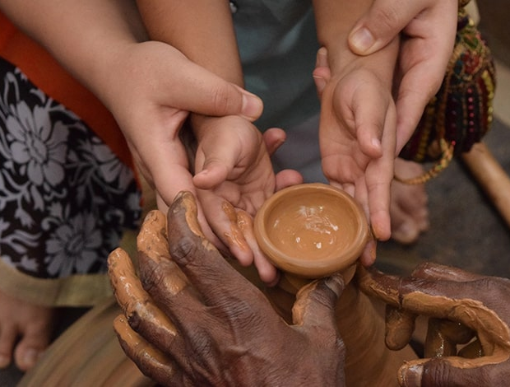
Shaping the habits of the mind
Hannah Marks
BA Hons (Theology), PG Dip (Theological Education)
hmarks@gatewayctc.ac.zw
Notes:
Want to welcome you to this online workshop, thank you for the hard work that you do – already had your work cut out for you before Covid pandemic.
‘Christianity always one generation away from extinction’ – why we do what we do, that the next generation may proclaim his work to those after them.
Hope that this challenges, encourages and inspires you.
As the title picture suggests the shaping of the habits of the mind is neither an easy nor a straightforward task. As theme of the conference denotes it takes a lifetime of learning and we are there to help at the start the process and we pray that the lifetime of learning begins by being

Slide 2
A couple of assumptions made in the title …
And… a brief definition:
habit | ˈhabɪt |
Noun
an acquired mode of behaviour that has become nearly or completely involuntary
Notes:
At the risk of sounding incredibly obvious – your children have minds. Now true, there are days where it may seem like this is far from the case, homework and classwork would seem to point in quite the other direction! BUT, not true.
That the mind has habits.
The minds can be shaped for good or for ill.
That educators are in the business of mind-shaping.
Those habits need purposeful and deliberate shaping on our parts.

Slide 3
For the Christian, shaping the mind and its habits is not now (nor has it ever been) neutral territory. It is a battlefield.
Notes:
Since the Fall of humanity there has been the greatest of battles - one side is God and truth, the other side was Satan and his lies.
Sinful human nature and the devil make sure of that.
Because if Christian educators and parents do not shape the habits of the mind then something or someone else more malevolent in its agenda will.
When men rebel against God they become their own false source of information on how to live.

Slide 4
Why does shaping the habits of the mind matter?
Notes:
Because whoever shapes the habits of the mind exerts incredible influence on an individual, or group, perhaps an entire generation.
Because the mind controls words→ actions → habits → character → destiny.
We will briefly cover two very crucial whys for shaping the habits of the mind matters. Before we look at what God says regarding the mind and its habits.

Slide 5
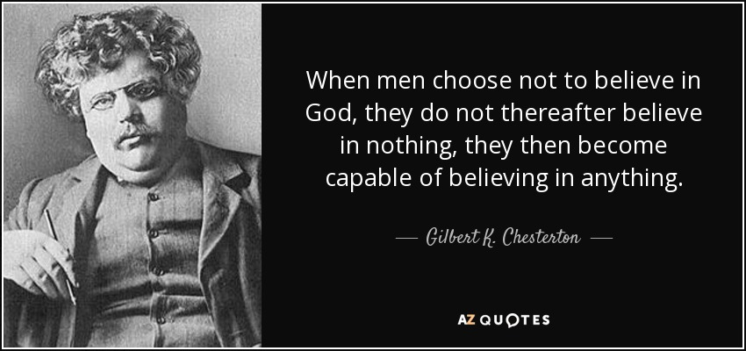
Notes:
We live in an age where we chose not to believe in God. This quote is the very why of why we must shape the habits of the mind. Because men and women now believe in a great many anything’s rather than God.
The spirit of anti-Christ, anti-God and anti-Bible is more publicly visible now than it was two or three decades ago.

Slide 6
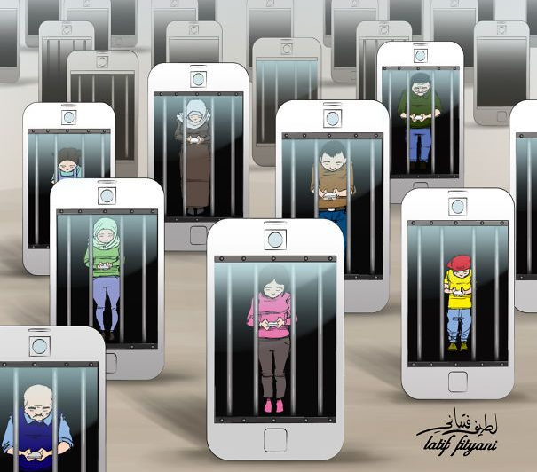
Who or what is currently shaping their minds and its habits?
Notes:
Technology is the very biggest shaper of the habits of the mind.
Shaping in extremely addictive and unhealthy ways.
(1 in 7 under-16s are so addicted to the web that they spend four hours or more glued to the screen,
3 y.o. is average age children starting using internet.)
But substance of what is in technology is media is the stuff that is consumed are shaping what they think on.
Many have accessed sexual content (either by mistake but then become addicted)
Sites on eating disorders, self harm, suicide sites, child abuse images.
If they don’t consume that then they very likely see highly sexualised, crude, body-obsessed, violent, cyber bullying, sensual content, outright weird, self hate and harm, drugs etc.
Or obsessively image focused, selfish, superficial, online-driven, artificial lives they are being urged to live.
What would you call this push– the habits of their minds are being SECULARISED – pushing God out.
Their mind is being bombarded with hundreds of millions of message a day with blatant and subliminal messaging of the values of a culture and world that are godless.
The amount of media we consume each day is why we as Christian educators must be more intentional, active, deliberate in shaping the habits of the mind.

Slide 7
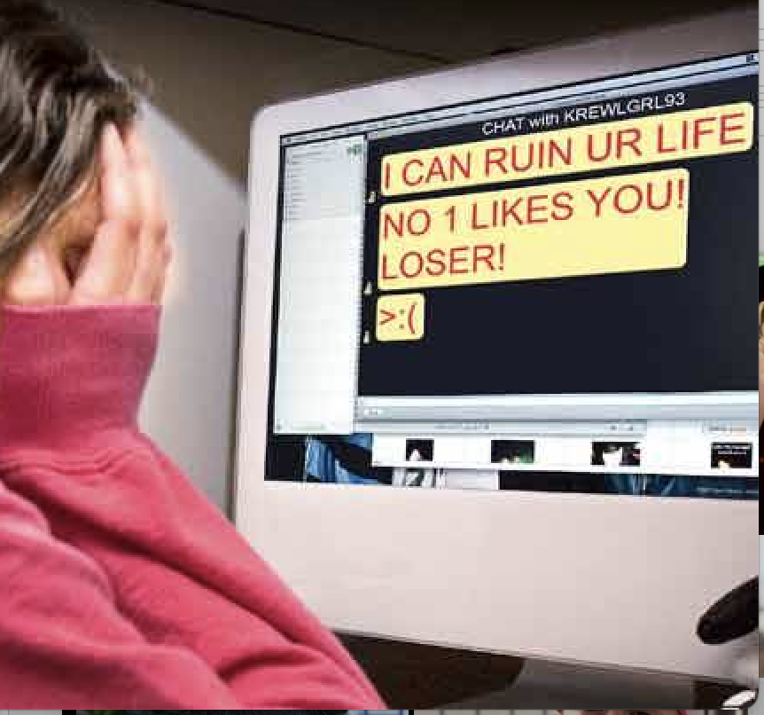
Christian education does not take place in a vacuum.
Notes:
We live in an increasingly dark world that we can no more shelter our children from.
This is what they see on their phones/ devices - on Netflix, on YouTube, or Instagram, or TikTok.
What habits or what agendas are their minds being pulled toward now?
Like it or not, this is the world our children are in and we cannot run and hide.
Our children NEED us, and God has CHOSEN YOU to be the one who will help arm your child for this fight.

Slide 8
“How do you communicate with a generation that listens with its eyes and thinks with its feelings?”

Slide 9
what does God say about the mind and its habits?

Slide 10
What is the mind?
Where thinking takes place. Home of thoughts, emotions, will & faith.
The mind is VERY important to the Christian.
God gives us our minds as a gift – a way to DISCOVER Him, to be used in His Service.
BUT our mental capacity is damaged by our moral condition.
Notes:
It also sets perspectives, judgments, loyalties, behaviours and actions.

Slide 11
What is The mind like because of the FALL?
Romans 1:21-32: Futile in our thinking, foolish hearts that are darkened, claiming to be wise but becoming fools, inventors of evil, disobedient to parents, haters of God, a debased mind.
All learners AND all teachers have a sin nature in their minds, as Paul describes. In the absence of a relationship with Christ, both experience the above.
This doesn’t just go away once we experience salvation. Every Christian must partner with God to renew their minds, on a daily basis.

Slide 12
Key instructions on the habits of the mind
Matthew 22: 37-38 ”You shall love the Lord your God with all your heart and with all your soul and with all your mind.”
Romans 12:2 “Do not be conformed to this world, but be transformed by the renewal of your mind, that by testing you may discern what is the will of God, what is good and acceptable and perfect.
Notes:
Of all the biblical passages on the mind these two stand out and these are I would say the pillars or the foundation stones of what we need to teach and train our students in.
We are all called (regardless of strength of gifting intellectually) to love with our minds and we must do that and teach our students to do that to best of our ability.
CS Lewis – Christ wants a child’s heart but a grown up’s head. Their faith must grow as their mind does.
Bible is very specific on what and how we must think – believers do not have freedom of thought.
Donovan Graham ‘Our minds are wonderful things, but they were created to work in concert with the mind of God, not autonomously.’ (2009, 54).

Slide 13
How do we shape the habits of the mind to LOVE God?
Teach the children to pray and worship in both their work and play. There is nothing so small that God is not interested in it.
Loving God with our minds means having a thought life which honours God – Phil 4:8.
Give the children permission to ask big, hard questions of the Bible and God, then help them search for bigger answers - 1 Pet 3:15.
Look for authentic (NOT contrived/ forced) connections between subject material and faith. Biblical Integration.
Each teacher must show that God is intimately interconnected with every area.
Notes:
When they are not coping/ fail a test/ fight/ upset we stop, care, pray. Show them there there is nothing so small God is not interested in it. Teach them to turn to him in prayer, each and every moment.
Teach them there is no question to big for God. ‘If God were small enough to be understood, he would not be big enough to be worshipped.’ (Evelyn Underhill.) Also, Alistair McGrath ‘The Christian faith is not irrational; it simply goes beyond reason.’
Teachers need to learn about apologetics as pre-evangelism to deal with the obstacles to the faith that students face now or later. Schools are the new place where the war of ideas are fought.
When you’re teaching– look for natural connections (not artificial, not forced ways) to connect things with God and faith. Pause and worship. Ask THEM how it makes them FEEL.
Remember default position of syllabi and textbooks is secular humanism – all-pervasive.

Slide 14
How do we shape habits of the mind to be transformed?
Realise thoughts are incredibly powerful, and God is aware of each one of them.
There are only 2 options – either our thoughts take us captive, or we take our thoughts captive (2 Cor 10:5).
Minds need daily renewing. We must hide Scripture in our heart, so it transforms us – Ps 119: 11, Rom 12:2.
‘The word of God can be in the mind without being in the heart; but it cannot be in the heart without being in the mind.’ R. C. Sproul.

Slide 15
Practical suggestions
Start cultivating open and talking relationships with your children. Do they know they can come to you and talk about ANYTHING?
Be proactive – not reactive. Expose your students to other worldviews, speak respectfully about the differences there.
Be ready for questions, if they aren’t asked, then you ask them! Help a child know why they believe what they believe.
Notes:
It is not sufficient to say that ‘a is wrong and b is right and stop with because the bible says so.’ There is far more to it than that and we have to first learn it for ourselves. Do your own research.
If we get to our children first about the critical issues then we shape their thinking biblically and intentionally before the world shapes it. Open communication and good relationships are vital to help children walking through the increasingly dangerous worldly minefield.

Slide 16
You are On earth. On purpose.
THE NEXT GENERATION NEEDS YOU
to help them shape the habits of their mind now for the day of battle yet to come.
Notes:
It is an urgent task that educators and parents need to partner in.
It is a lifelong journey.
In the Anglican church when someone is baptized this is said over them: “Fight valiantly as a disciple of Christ against sin, the world and the devil, and remain faithful to Christ to the end of your life.” This is surely our goal in our pursuit of the Christian mind.
And who knows but that you have come to your royal position for such a time as this?” Esther 4:14b

