Slide 1
ACSI (Zimbabwe) Christian Educators Conference 2022
THEME: “Jesus – our hope in a hopeless world”
Workshop Session:
“ How Does a School Counsellor, Counsel with Hope”

Slide 2
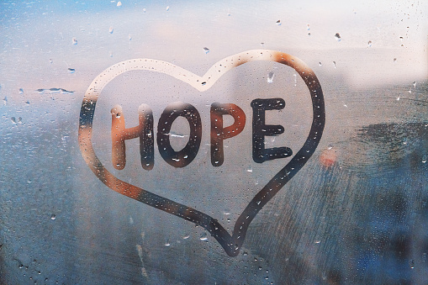
HOPE:
noun
Aspiration ,desire, wish, expectation, aim, plan, dream, longing, yearning, craving, hankering …
Verb
Expect, anticipate, look for, wait for, pin one's hopes on, want ….

Slide 3
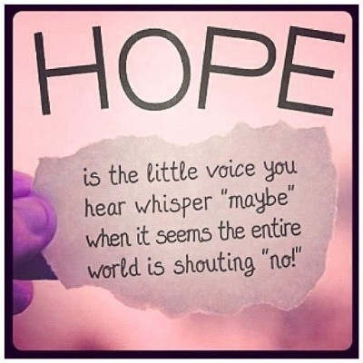
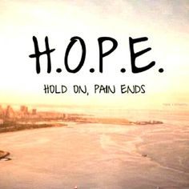

Slide 5
“Our salvation has a past, completed aspect (we are saved) a present aspect (we are being saved through sanctification) and a future aspect (we will be saved, changed to be like Him when we see Him face to face). The fact that God is involved, that He is in the counselling room with us, gives enormous hope. He is doing the work.”

Slide 6
The fact that God is involved, means we have at our disposal: -
The Word – (important however that we don’t become preachy but that we elicit).
Prayer – He answers.
Holy Spirit – He speaks to the counsellor and guides, He speaks to the client and gives insight, direction, healing etc.

Slide 7
HOPE - How can we as Counsellors Instill Hope?
Firstly – we can share scriptural truths and that we have reassurance on the unchanging nature of God.
Secondly – to help counselees examine their self – defeating logic – ideas like “I’ll never get better” or “Nothing can be worse than this” – these ideas can be gently challenged
Thirdly – counsellors can get the counselee moving and doing something – even a minimal activity gives the feeling that something is being done and that they are not helpless. This can arouse hope, especially if the activity accomplishes something worthwhile, e.g.- Poetry, journaling, art, play therapy, sand tray therapy or even just going for a walk. Etc.

Slide 8
How do we bring hope to children and teens? –
by responding to their true needs
by being the listening ear, they need.
Demonstrating love and care
Making them feel they deserve happiness
Show acceptance
Show appreciation
Help them find their passion
Help them get control of things that are out of their control
Staying connected.

Slide 9
As a Christian School counsellor, I feel we can help instill Hope by :–
Providing a safe place/space
Listen
Confide
Offer Insight
Be a role model
Respect and Validate their experiences
Slow down

Slide 10
A tip : –
If we read scripture, we look for Who He is – a name, characteristic or comparison, then write who you are in contrast or who you are because of who He is. e.g.
In John 4, Jesus talks to the Samaritan woman at the well and speaks of Living water – He is the living water – in contrast --- ‘I am the one who is thirsty, the recipient of His refreshing.’
Isiah used this same identity clarification thinking when he calls God the potter and we are the clay.

Slide 11
Psalm 139 vs 10:
“Even there your hand shall lead me, and your right hand shall hold me.”

Slide 12
The Tree of Life: A Simple Exercise for Reclaiming Your Identity and Direction in Life Through Story
The Tree of Life Concept
The tree of life concept is pretty simple and straightforward. It is a visual metaphor in which a tree represents your life and the various elements that make it up–past, present, and future.
By labelling these parts, you not only begin to discover (or perhaps rediscover) aspects of yourself shaped by the past, but you can then begin to actively cultivate your tree to reflect the kind of person you want to be moving forward.
The Tree of Life Exercise
The first step is to draw a tree.
Next, follow the labelling instructions below. If you can only think of one or two things per section at a time, don’t worry about it. The nature of this exercise is that as you complete each step, it unlocks more memories and ideas for other parts. You can skip around and fill things in at any time. The most helpful thing in the beginning is to just write stuff down and see where it takes you. You might be surprised!

Slide 13
The Compost Heap (Optional–But Highly Recommended!)
Write down anything in your compost heap that would normally go in the other sections described below but which are now things you no longer want to be defined by.
These are often sources of trauma, abuse, cultural standards of normality/beauty/etc. or anything else that shapes negative thoughts about yourself in your mind. You can write down places, people, problems, experiences. Whatever you need to.
Generally they all have to do with past trauma and damaging relationships you are trying to let go of. The idea of a compost heap is an extremely helpful way to think about these things. Especially since many of them are not neatly categorized as “all bad”.
The Roots
Write down where you come from on the roots. This can be your home town, state, country, etc. You could also write down the culture you grew up in, a club or organization that shaped your youth, or a parent/guardian.
The Ground
Write down the things you choose to do on a weekly basis on the ground. These should not be things you are forced to do, but rather things you have chosen to do for yourself.
The Trunk
Write your skills and values on the trunk. Might choose to write values starting at the base of the trunk going up, then transitioned into listing skills.

Slide 14
The Branches
Write down your hopes, dreams, and wishes on the branches. These can be personal, communal, or general to all of mankind. Think both long and short term. Spread them around the various branches.
The Leaves
Write down the names of those who are significant to you in a positive way. Your friends, family, pets, heroes, etc.
The Fruits
Write down the legacies that have been passed on to you. You can begin by looking at the names you just wrote on leaves and thinking about the impact they’ve had on you and what they’ve given to you over the years. This can be material, such as an inheritance, but most often this will be attributes such as courage, generosity, kindness, etc.
(Tip: if your tree is pretty crowded by this point, perhaps try drawing some baskets of fruit at the base of your tree and label them accordingly there.)
The Flowers & Seeds
Write down the legacies you wish to leave to others on the flowers and seeds.
(Tip: again, you may wish to de-clutter your drawing by visualizing saplings, baskets of flowers, etc. on which to write these items down.)

Slide 15
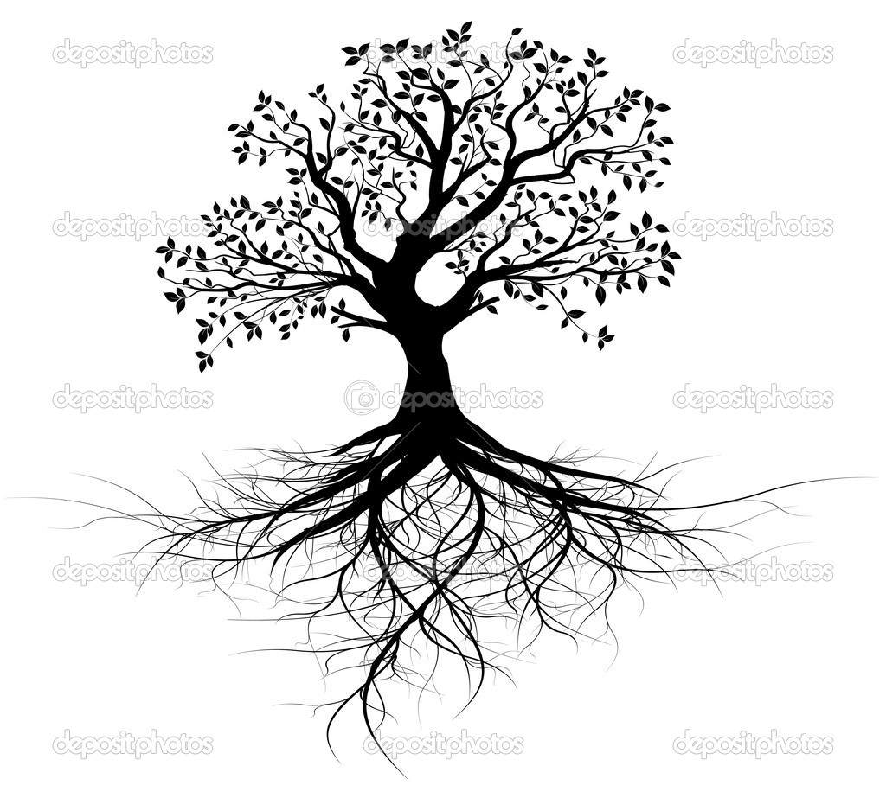
Going Further
Here are two things that you might choose to do as a follow up to the initial experience.
Journaling
Journal about the various elements on your tree. Explore the connections between roots, values, skills, people, etc. in a safe way before sharing it with others in any organized manner.
Writing Letters
To the people who have instilled something special in you.
.

Slide 16
RESOURCES:-
Christian Counselling – A Comprehensive Guide by Gary R. Collins Ph.D.
Tree of Life: Simple Exercise for Reclaiming you Identity and Direction in Life Through Story.
Pinterest for Object lesson.

