Slide 1
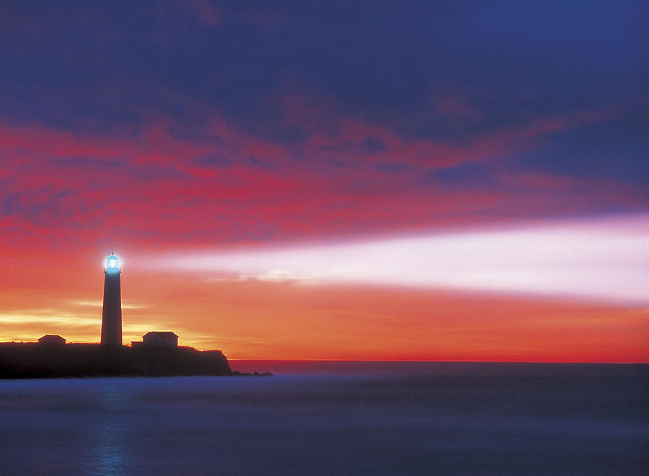
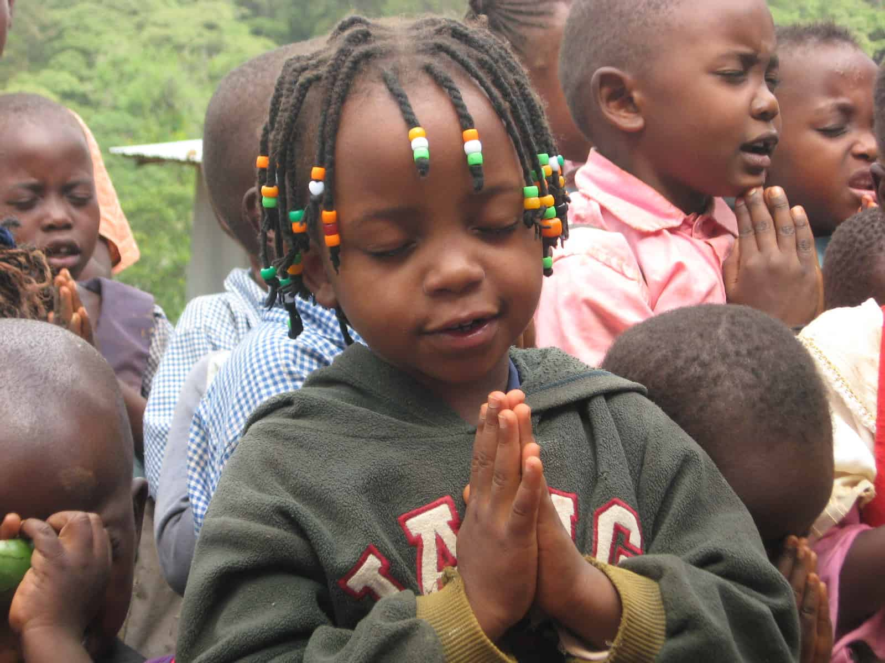
Empowering relevant, high-quality, holistic education
in member, non-profit, independent schools
SCHOOLS
KLAXONS OF HYPE
OR BEACONS OF HOPE?

Slide 2
Empowering relevant, high-quality, holistic education
in member, non-profit, independent schools
HYPE
HOPE
“Whom the gods wish to destroy
they first call promising”
“The promises of yesterday …
are the taxes of today”
“Hope in reality is the worst of all evils as it prolongs the torments of men”
“Promises are like babies…
easy to make, hard to deliver”
KLAXONS OF HYPE OR BEACONS OF HOPE?

Slide 3
Empowering relevant, high-quality, holistic education
in member, non-profit, independent schools
HYPE
HOPE
NOISE
LIGHT
REPUTATION
VISION
SELF
OTHERS
GLORY
FEW
MAN’S
GOD’S
ALL
PRESENT
FUTURE
VICTORIES
VALUES
PROFIT
PROPHECY
KLAXONS OF HYPE OR BEACONS OF HOPE?

Slide 4
Empowering relevant, high-quality, holistic education
in member, non-profit, independent schools
HYPE
HOPE
SUCCESS
SUFFERING
INDEPENDENCE
INTERDEPENDENCE
SENIORITY
SERVICE
GLORY
MAN’S
GOD’S
POSITION
POTENTIAL
SCHOOL SPIRIT
CHILD’S SPIRIT
RULES
SPIRIT
KLAXONS OF HYPE OR BEACONS OF HOPE?

Slide 5
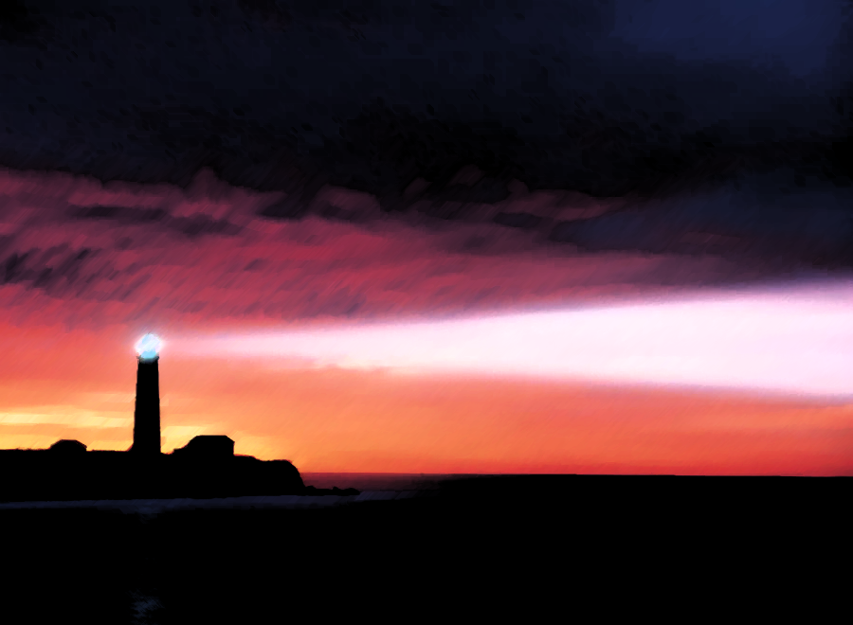
Empowering relevant, high-quality, holistic education
in member, non-profit, independent schools
HOPE
HOW CAN SCHOOLS BE BEACONS OF
PRINCIPLES
SPIRITUAL
POLICIES
BIBLICAL
PROCEDURES
PERSONAL
PRACTICES
ETERNAL
"For everything that was written in the past was written to teach us so that through the endurance taught in the Scriptures and the encouragement they provide we might have hope.”
KLAXONS OF HYPE OR BEACONS OF HOPE?

Slide 6
Empowering relevant, high-quality, holistic education
in member, non-profit, independent schools
HOPE
HOW CAN SCHOOLS BE BEACONS OF
PRINCIPLES
PRESENCE OF GOD
GOD
JOHN 3:16
FIRST OF ALL
SPIRIT NOT LAW
"For God so loved the world, that He gave his only Son, so that whoever believes in Him should not perish but have eternal life.”
KLAXONS OF HYPE OR BEACONS OF HOPE?

Slide 7
Empowering relevant, high-quality, holistic education
in member, non-profit, independent schools
HOPE
HOW CAN SCHOOLS BE BEACONS OF
PRINCIPLES
LOVE OF GOD
SO LOVED
JOHN 3:16
HEART OF ALL
PEOPLE NOT REPUTATION
"For God so loved the world, that He gave his only Son, so that whoever believes in Him should not perish but have eternal life.”
KLAXONS OF HYPE OR BEACONS OF HOPE?

Slide 8
Empowering relevant, high-quality, holistic education
in member, non-profit, independent schools
HOPE
HOW CAN SCHOOLS BE BEACONS OF
PRINCIPLES
PEOPLE OF GOD
THE WORLD
JOHN 3:16
CALL OF ALL
WORLD NOT SCHOOL
"For God so loved the world, that He gave his only Son, so that whoever believes in Him should not perish but have eternal life.”
KLAXONS OF HYPE OR BEACONS OF HOPE?

Slide 9
Empowering relevant, high-quality, holistic education
in member, non-profit, independent schools
HOPE
HOW CAN SCHOOLS BE BEACONS OF
PRINCIPLES
DECISION OF GOD
THAT
JOHN 3:16
CONSEQUENCE OF ALL
ACTION NOT WORD
"For God so loved the world, that He gave his only Son, so that whoever believes in Him should not perish but have eternal life.”
KLAXONS OF HYPE OR BEACONS OF HOPE?

Slide 10
Empowering relevant, high-quality, holistic education
in member, non-profit, independent schools
HOPE
HOW CAN SCHOOLS BE BEACONS OF
PRINCIPLES
GRACE OF GOD
HE GAVE
JOHN 3:16
BEST OF ALL
FORGIVEN NOT DESERVED
"For God so loved the world, that He gave his only Son, so that whoever believes in Him should not perish but have eternal life.”
KLAXONS OF HYPE OR BEACONS OF HOPE?

Slide 11
Empowering relevant, high-quality, holistic education
in member, non-profit, independent schools
HOPE
HOW CAN SCHOOLS BE BEACONS OF
PRINCIPLES
SALVATION OF GOD
ONLY SON
JOHN 3:16
GREATEST OF ALL
SERVANT NOT MASTER
"For God so loved the world, that He gave his only Son, so that whoever believes in Him should not perish but have eternal life.”
KLAXONS OF HYPE OR BEACONS OF HOPE?

Slide 12
Empowering relevant, high-quality, holistic education
in member, non-profit, independent schools
HOPE
HOW CAN SCHOOLS BE BEACONS OF
PRINCIPLES
PURPOSE OF GOD
JER. 29:11
SO THAT
JOHN 3:16
PLAN OF ALL
JOURNEY NOT DESTINATION
"For God so loved the world, that He gave his only Son, so that whoever believes in Him should not perish but have eternal life.”
KLAXONS OF HYPE OR BEACONS OF HOPE?

Slide 13
Empowering relevant, high-quality, holistic education
in member, non-profit, independent schools
HOPE
HOW CAN SCHOOLS BE BEACONS OF
PRINCIPLES
CHOSEN OF GOD
WHOEVER
JOHN 3:16
CHOICE OF ALL
WILLING NOT TALENTED
"For God so loved the world, that He gave his only Son, so that whoever believes in Him should not perish but have eternal life.”
KLAXONS OF HYPE OR BEACONS OF HOPE?

Slide 14
Empowering relevant, high-quality, holistic education
in member, non-profit, independent schools
HOPE
HOW CAN SCHOOLS BE BEACONS OF
PRINCIPLES
SALVATION OF GOD
BELIEVES
JOHN 3:16
CAPABLE OF ALL
FAITH NOT WORKS
"For God so loved the world, that He gave his only Son, so that whoever believes in Him should not perish but have eternal life.”
KLAXONS OF HYPE OR BEACONS OF HOPE?

Slide 15
Empowering relevant, high-quality, holistic education
in member, non-profit, independent schools
HOPE
HOW CAN SCHOOLS BE BEACONS OF
PRINCIPLES
SON OF GOD
IN HIM
JOHN 3:16
GREATEST OF ALL
SAVIOUR NOT CONQUEROR
"For God so loved the world, that He gave his only Son, so that whoever believes in Him should not perish but have eternal life.”
KLAXONS OF HYPE OR BEACONS OF HOPE?

Slide 16
Empowering relevant, high-quality, holistic education
in member, non-profit, independent schools
HOPE
HOW CAN SCHOOLS BE BEACONS OF
PRINCIPLES
MERCY OF GOD
NOT PERISH
JOHN 3:16
RELIEF OF ALL
FUTURE NOT PUNISHMENT
"For God so loved the world, that He gave his only Son, so that whoever believes in Him should not perish but have eternal life.”
KLAXONS OF HYPE OR BEACONS OF HOPE?

Slide 17
Empowering relevant, high-quality, holistic education
in member, non-profit, independent schools
HOPE
HOW CAN SCHOOLS BE BEACONS OF
PRINCIPLES
REWARD OF GOD
HAVE
JOHN 3:16
IN REACH OF ALL
AVAILABLE NOT UNOBTAINABLE
"For God so loved the world, that He gave his only Son, so that whoever believes in Him should not perish but have eternal life.”
KLAXONS OF HYPE OR BEACONS OF HOPE?

Slide 18
Empowering relevant, high-quality, holistic education
in member, non-profit, independent schools
HOPE
HOW CAN SCHOOLS BE BEACONS OF
PRINCIPLES
EXTENT OF GOD
JOHN 3:16
ETERNAL LIFE
FULLNESS OF ALL
NOW AND FUTURE
"For God so loved the world, that He gave his only Son, so that whoever believes in Him should not perish but have eternal life.”
KLAXONS OF HYPE OR BEACONS OF HOPE?

Slide 19
Empowering relevant, high-quality, holistic education
in member, non-profit, independent schools
HOPE
HOW CAN SCHOOLS BE BEACONS OF
PRINCIPLES
LIGHT OF GOD
JOHN 3:19
LIGHT
GOOD OF ALL
SHINE AND BLAZE
“The light has come into the world, and people loved the darkness rather than the light because their works were evil.”
KLAXONS OF HYPE OR BEACONS OF HOPE?

Slide 20
Empowering relevant, high-quality, holistic education
in member, non-profit, independent schools
HOPE
HOW CAN SCHOOLS BE BEACONS OF
GLORY
CHRIST IN YOU
COL 1:27
“To them God chose to make known how great among the Gentiles are the riches of the glory of this mystery, which is Christ in you, the hope of glory..”
KLAXONS OF HYPE OR BEACONS OF HOPE?

Slide 21
Empowering relevant, high-quality, holistic education
in member, non-profit, independent schools
HOPE
HOW CAN SCHOOLS BE BEACONS OF
“Everything was written... so that… we might have hope”
Rom 15:4
“Remember your creator in the days of your youth.”
KLAXONS OF HYPE OR BEACONS OF HOPE?

Slide 22
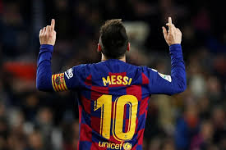
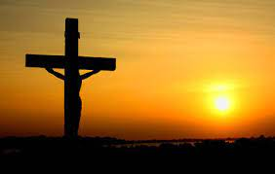
Empowering relevant, high-quality, holistic education
in member, non-profit, independent schools
HYPE
HOPE
MESSI-AH
GLORY
KLAXONS OF HYPE OR BEACONS OF HOPE?

Slide 23
Empowering relevant, high-quality, holistic education
in member, non-profit, independent schools
Lord, the light of your love is shining In the midst of the darkness, shining Jesus, Light of the world, shine upon us Set us free by the truth you now bring us Shine on me, shine on me
Shine, Jesus, shine. Fill this land with the Father's glory Blaze, Spirit, blaze; Set our hearts on fire Flow, river, flow. Flood the nations with grace and mercy Send forth your word Lord, and let there be light
Shine on me
Shine on me
As we gaze on your kingly brightness
So our faces display your likeness
Ever changing from glory to glory
Mirrored here may our lives tell your story
KLAXONS OF HYPE OR BEACONS OF HOPE?

